Slide 1
Discrete Mathematics
Relations

Slide 2
n-ary Relations
Let A1, A2 ,..., An be sets. An n-ary relation on these sets is a subset of A1 × A2 ×···× An.
The sets A1, A2 ,..., An are called the domains of the relation, and n is called its degree.

Slide 3
n-ary Relations
Example
Let R be the relation on N × N × N consisting of triples (a, b, c), where a, b, and c are integers
with a<b<c.
Then (1, 2, 3) ∈ R, but (2, 4, 3) R. The degree of this relation is 3. Its domains are all equal to the set of natural numbers.

Slide 4
Closure of Relation
A computer network has data centers in Boston, Chicago, Denver, Detroit, NewYork, and San Diego.

Slide 5
Closure of Relation
One-way telephone lines
from Boston to Chicago
from Boston to Detroit
from Chicago to Detroit
from Detroit to Denver
from New York to San Diego
Let R be the relation containing (a, b) if there is a telephone line from the data center in a to that in b.

Slide 6
Closure of Relation
How can we determine if there is some (possibly indirect) link composed of one or more telephone lines from one center to another?
Because not all links are direct, such as the link from Boston to Denver that goes through Detroit, R cannot be used directly to answer this.
In the language of relations, R is not transitive, so it does not contain all the pairs that can be linked.

Slide 7
Closure of Relation
we can ﬁnd all pairs of data centers that have a link by constructing a transitive relation S containing R such that S is a subset of every transitive relation containing R. Here, S is the smallest transitive relation that contains R. This relation is called the transitive closure of R.

Slide 8
Closure of Relation
If there is a relation S with property P containing R such that S is the subset of every relation with property P containing R, then S is called the closure of R with respect to P .

Slide 9
The Reﬂexive closure of R is R ∪ ∆
The Symmetric closure of R is the relation R ∪ R⁻¹
The Transitive closure of R is the relation
R* = R ∪ R² ∪ R³ ∪ …….∪ R^{n}
Where R² = R ◦ R
R³ = R² ◦ R
.
R^{n} = R^{n-1} ◦ R

Slide 10
Example of Reflexive Closure
A={1, 2, 3, 4}
R={(1,1), (1,3), (2,4), (3,1), (3,3), (4,3)}
∆ = {(1,1), (2,2), (3,3), (4,4)}
Reflexive closure of R is R ∪ ∆
Reflexive(R) = {(1,1), (1,3), (2,4), (3,1), (3,3), (4,3)} ∪ {(1,1), (2,2), (3,3), (4,4)}

Slide 11
Example of Symmetric Closure
A={1, 2, 3, 4}
R={(1,1), (1,3), (2,4), (3,1), (3,3), (4,3)}
R⁻¹ = {(1,1), (3,1), (4, 2), (1, 3), (3,3), (3, 4)}
Symmetric closure of R is R ∪ R⁻¹
Symmetric(R) = {(1,1), (1,3), (2,4), (3,1), (3,3), (4,3)} ∪ {(1,1), (3,1), (4, 2), (1, 3), (3,3), (3, 4)}

Slide 12
Example of Transitive closure
A = {1, 2, 3}
R = {(1,2), (2,3), (3,3))
R² = R ◦ R = {(1,3), (2,3), (3,3)}
R³ = R² ◦ R = {(1,3), (2,3), (3,3)}
Transitive (R) = R ∪ R² ∪ R³
= {(1,2), (2,3), (3,3), (1,3))}

Slide 13
Equivalence Relation
1/2 , 2/4 , 3/6, −1/−2, −3/−6, 15/30, and so on
are all different ways to represent the same number. They may look different; they may be called different names; but they are all equal. The idea of grouping together things that “look different but are really the same” is the central idea of equivalence relations.

Slide 14
Equivalence Relation
A relation on a set A is called an equivalence relation if it is reﬂexive, symmetric, and transitive.

Slide 15
Equivalence Relation
A relation on a set A is called an equivalence relation if it is reﬂexive, symmetric, and transitive.

Slide 16
Equivalence Relation
Two elements a and b that are related by an equivalence relation are called equivalent. The notation a ∼ b is often used to denote that a and b are equivalent elements with respect to a particular equivalence relation.

Slide 17
Equivalence Relation
Let R be the relation on the set of real numbers such that aRb if and only if a − b is an integer.
Is R an equivalence relation?

Slide 18
Equivalence Relation
Is it reflexive?
Because a −a = 0 is an integer for all real numbers a, aRa for all real numbers a.
Hence, R is reﬂexive.

Slide 19
Equivalence Relation
Is it symmetric?
Now suppose that aRb. Then a −b is an integer, so b−a is also an integer. Hence, bRa. It follows that R is symmetric.

Slide 20
Equivalence Relation
Is it transitive?
If aRb and bRc, then a −b and b−c are integers.
Therefore, a−c = (a −b) + (b−c) is also an integer. Hence, aRc. Thus, R is transitive.

Slide 21
Equivalence Relation
So, R is an equivalence relation

Slide 22
Relation Induced by Partition
A partition of a set A is a finite or infinite collection of nonempty, mutually disjoint subsets whose union is A.

Slide 23
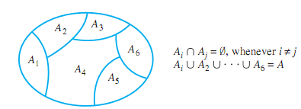
Relation Induced by Partition
The diagram illustrates a partition of a set A by subsets A₁, A₂,..., A₆.

Slide 24
Relation Induced by Partition
Given a partition of a set A, the relation induced by the partition, R, is defined on A as follows: For all x, y ∈ A,
xRy ⇔ there is a subset A_{i} of the
partition such that both x
and y are in A_{i} .

Slide 25
Relation Induced by Partition
Let A ={0, 1, 2, 3, 4} and consider the following partition of A:
{0, 3, 4}, {1}, {2}.
What is the relation R induced by this partition?

Slide 26
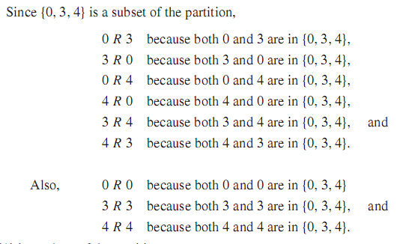
Relation Induced by Partition

Slide 27
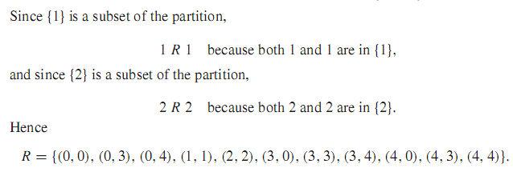
Relation Induced by Partition
The fact is that a relation induced by a partition of a set satisfies all three properties: reﬂexivity, symmetry, and transitivity.

Slide 28
Equivalence Classes
Equivalence Classes / Equivalence Classes of Relation
Consider the relation R on A that consists of all pairs (x, y), where x and y graduated from the same high school
Set of all students who graduated from the same high school as x did
This subset of A is called an equivalence class of the relation.

Slide 29
Equivalence Classes
Equivalence Classes / Equivalence Classes of Relation
Suppose A is a set and R is an equivalence relation on A. For each element a in A, the equivalence class of a, denoted [a] and called the class of a for short, is the set of all elements x in A such that x is related to a by R.
In symbols: [a]={x ∈ A | xRa}

Slide 30
Equivalence Classes
Equivalence Classes / Equivalence Classes of Relation
Let A ={0, 1, 2, 3, 4}
R ={(0, 0), (0, 4), (1, 1), (1, 3), (2, 2), (3, 1), (3, 3), (4, 0), (4, 4)}
Equivalent Class?

Slide 31
Equivalence Classes
Equivalence Classes / Equivalence Classes of Relation
Equivalence class of every element of A
^{[0]={x ∈ A | x R 0}={0, 4}}
^{[1]={x ∈ A | x R 1}={1, 3}}
^{[2]={x ∈ A | x R 2}={2}}
^{[3]={x ∈ A | x R 3}={1, 3}}
^{[4]={x ∈ A | x R 4}={0, 4}}
Note that [0]=[4] and [1]=[3]. Thus the distinct equivalence classes of the relation are
^{{0, 4}, {1, 3}, and {2}}

Slide 32

Antisymmetric Relation
A relation R on set A is antisymmetric if whenever aRb and bRa then a=b, that is, if whenever (a, b), (b, a) ∈ R then a=b. (b, a)∈ R . Thus R is not antisymmetric if there exists a, b ∈ A such that (a, b) and (b, a) belong to R but a b
A={1,2,3,4}
R₁ ={(1,1),(1,2),(2,3),(1,3),(4,4)}
R₂ ={(1,1),(1,2),(2,1),(2,2),(3,3), (4,4)} - Not Antisymmetric
R₃ ={(1,3),(2,1)}
R₄ =Φ, the empty relation
R₅ = AxA, the universal relation - Not Antisymmetric

Slide 33
Partial Ordering Relation
A relation R on set A is called partial ordering or a partial order if it is reﬂexive, antisymmetric, and transitive.
A set A together with a partial ordering R is called a partially ordered set or poset.

Slide 34
Example of Partial Ordering Relation
“Less Than or Equal to” Relation
Let S be a set of real numbers and deﬁne the “less than or equal to” relation, ≤, on S as follows: For all real numbers x and y in S,
x ≤ y ⇔ x < y or x = y.

Slide 35
Example of Partial Ordering Relation
“Less Than or Equal to” Relation
≤ is reﬂexive: For ≤ to be reﬂexive means that x ≤ x for all real numbers x in S. But x ≤ x means that x < x or x = x, and x = x is always true.

Slide 36
Example of Partial Ordering Relation
“Less Than or Equal to” Relation
≤ is antisymmetric: For ≤ to be antisymmetric means that for all real numbers x and y in S, if x ≤ y and y ≤ x then x = y. This follows immediately from the deﬁnition of ≤ and the trichotomy property which says that given any real numbers, x and y, exactly one of the following holds: x < y or x = y or x > y.

Slide 37
Example of Partial Ordering Relation
“Less Than or Equal to” Relation
≤ is reﬂexive: For ≤ to be reﬂexive means that x ≤ x for all real numbers x in S. But
x ≤ x means that x < x or x = x, and x = x is always true.
≤ is antisymmetric: For ≤ to be antisymmetric means that for all real numbers x and
y in S,if x ≤ y and y ≤ x then x = y. This follows immediately from the definition
of ≤ and the trichotomy property (see Appendix A, T17), which says that given any real
numbers, x and y, exactly one of the following holds: x < y or x = y or x > y.
≤ is transitive: For ≤ to be transitive means that for all real numbers x, y, and z in S
if x ≤ y and y ≤ z then x ≤ z. This follows from the definition of ≤ and the transitivity
property of order (see Appendix A, T18), which says that given any real numbers x, y,
and z, if x < y and y < z then x < z.
Because ≤ is reflexive, antisymmetric, and transitive, it is a partial order relation. ■

Slide 38
Example of Partial Ordering Relation
“Less Than or Equal to” Relation
≤ is transitive: For ≤ to be transitive means that for all real numbers x, y, and z in S if x ≤ y and y ≤ z then x ≤ z. This follows from the deﬁnition of ≤ and the transitivity property of order which says that given any real numbers x, y, and z, if x < y and y < z then x < z.
As ≤ is reﬂexive, antisymmetric, and transitive, it is a partial order relation

